Slide 1
smart agriculture monitoring
Bhavana
Ramya
Nikhitha

Slide 2
Project description
In India agriculture plays a very important role. The Indian economy is also greatly affected by agricultural, as about 50 percent of total population is directly or indirectly depend on the agricultural related activities. A farmer has to go to the farm to check the water level in the field and to turn on and turn off the water pump, sometimes even in the middle of the night. This problem can be overcome by improving old methods of farming. A new system can be developed or designed which transform the old traditional farming into the smart farming. This tries to design a simple water pump controller by using a soil moisture sensor and Esp8266 NodeMCU-12E. A Message Queue Telemetry Transport protocol is used for transmitting(MQTT) and receiving sensor information. Depending on a status of soil moisture content NodeMCU-12E controls a water pump action and displays the soil moisture sensor data and water pump status on a web page or mobile application. In this way, a secure, flexible, trust-able and economical system is developed to solve above mentioned agricultural irrigation problem.

Slide 3
Abstarct:
*Usually farmers go a long way to their fields to water their crop land. Adequate
water supply is essential for agriculture; crops can be damaged by either water
excess or shortage, in order to avoid that this method is used.
*using smart agriculture method the fields can be watered automatically when
the moisture content, of the soil is below the threshold value
*The farmer gets the notification about the status of his field if the moisture
content, humidity and temperature is below threshold value, in the form of
message, after viewing the message with the help of user interface, farmer can
turn on motor which supply water to the field, if the water content is equal to
threshold value then he will get a message to turn of the motor.
* even the farmer can view the status in the form of graph

Slide 4
Features:
*Water will be supplied to field automatically when we on the motor
using button
*After the moisture content is equal to threshold value ,we can off
the water supply using button
*We can adjust the amount of water supply using servo motor

Slide 5
Existing system
It is tedious to go near the field and on the water supply whenever
moisture content is low

Slide 6
Proposed System
:* using smart agriculture method the fields can be watered automatically when the moisture
content, of the soil is below the threshold value
*The farmer gets the notification about the status of his field if the moisture content, humidityand temperature is below threshold value, in the form of message, after viewing the messagewith the help of user interface, farmer can turn on motor which supply water to the field, ifthe water content is equal to threshold value then he will get a message to turn of the motor.

Slide 7
Software Requirements:
*Arduino IDE
*Node js
*Mongo db
*Mosquitto

Slide 8
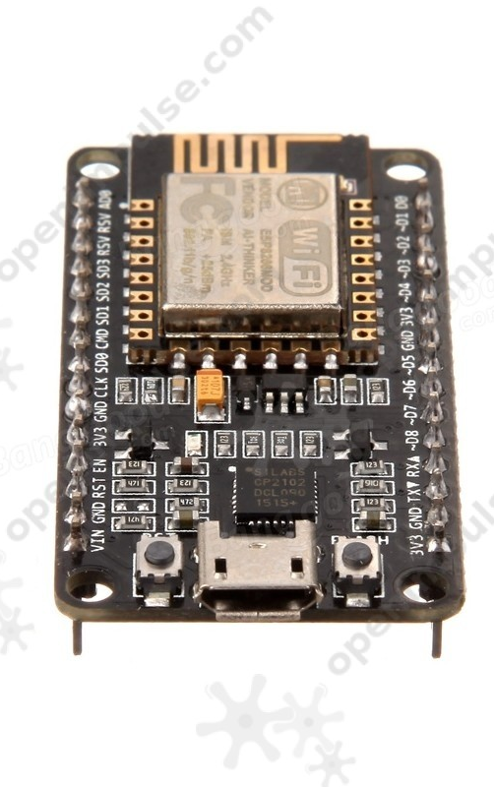
Nodemcu(ESP8266)
Here is another way of developing NodeMCU with a well-known IDE i.e. Arduino IDE. We can also develop applications on NodeMCU using Arduino development environment. This makes easy for Arduino developers than learning new language and IDE for NodeMCU.

Slide 9
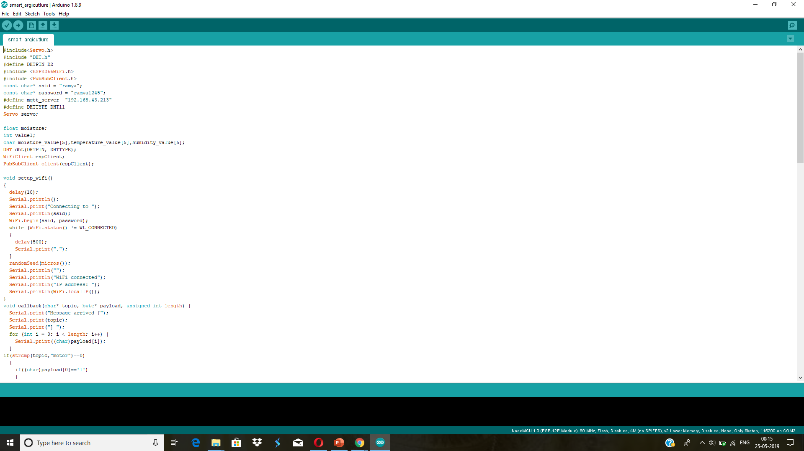
Arduino ide

Slide 10
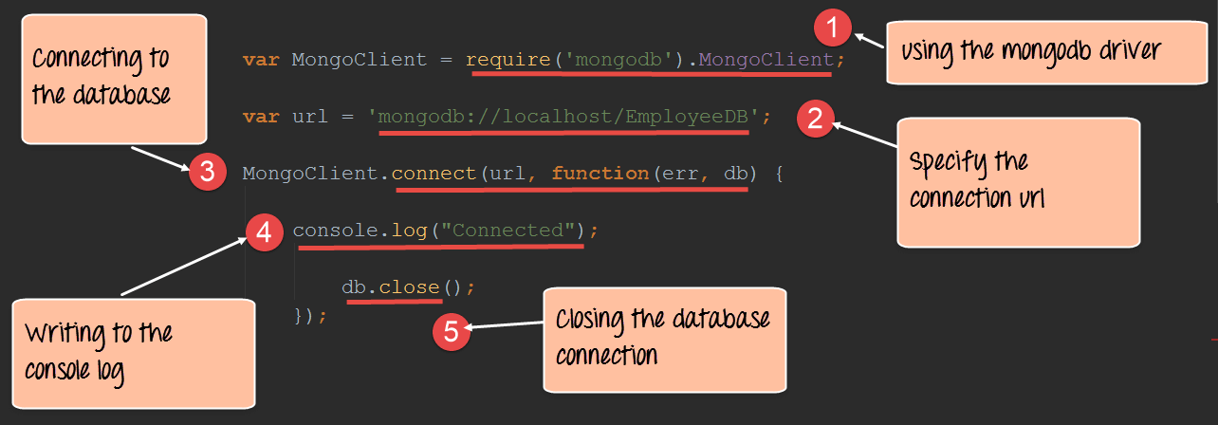
Working of mongodb

Slide 11
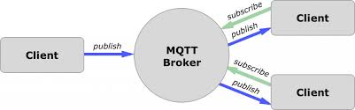
Mqtt protocal

Slide 12
Hardware Requirements
*Soil moisture sensor
*ESP8266
*servo motor
*humidity & temperature sensor
*DC motor
*L293D-motor driver
*male and female headers

Slide 13
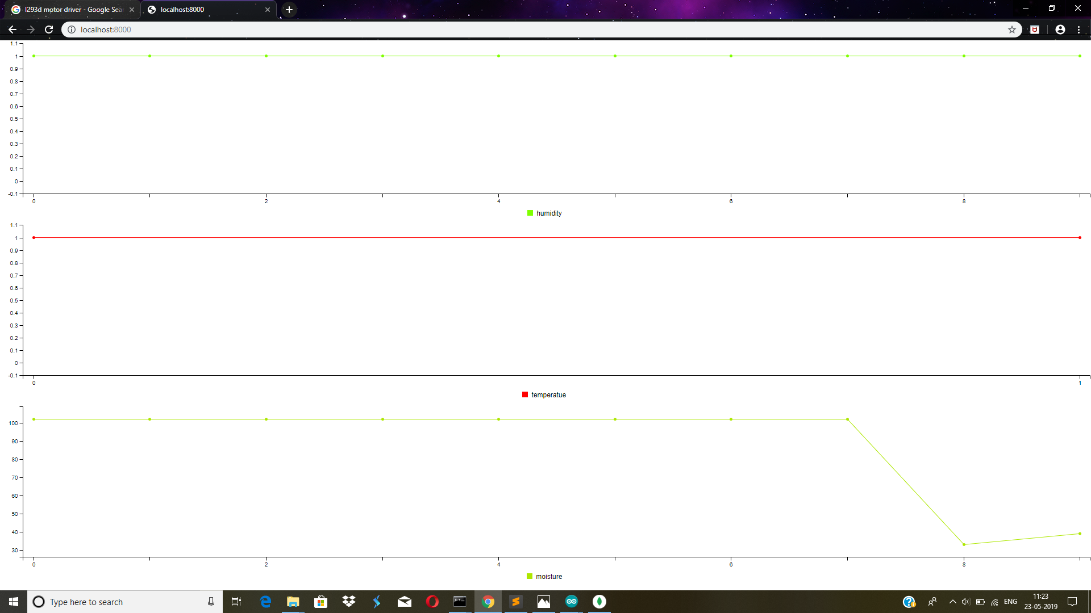
Graph display

Slide 14
Advantages
*It is of low cost and can be afforded by the farmer. It can
also be employed in monitoring or processing major
*required data in agriculture
*The proposed idea helps a lot in reducing the manual
effort and advancement

Slide 15
Disadvantages
*Fail to work properly when sensor working fails
*lack of accurancy due to large particles
*each type of soil should be calibrated

Slide 16
Thank you any queries?

